Slide 1
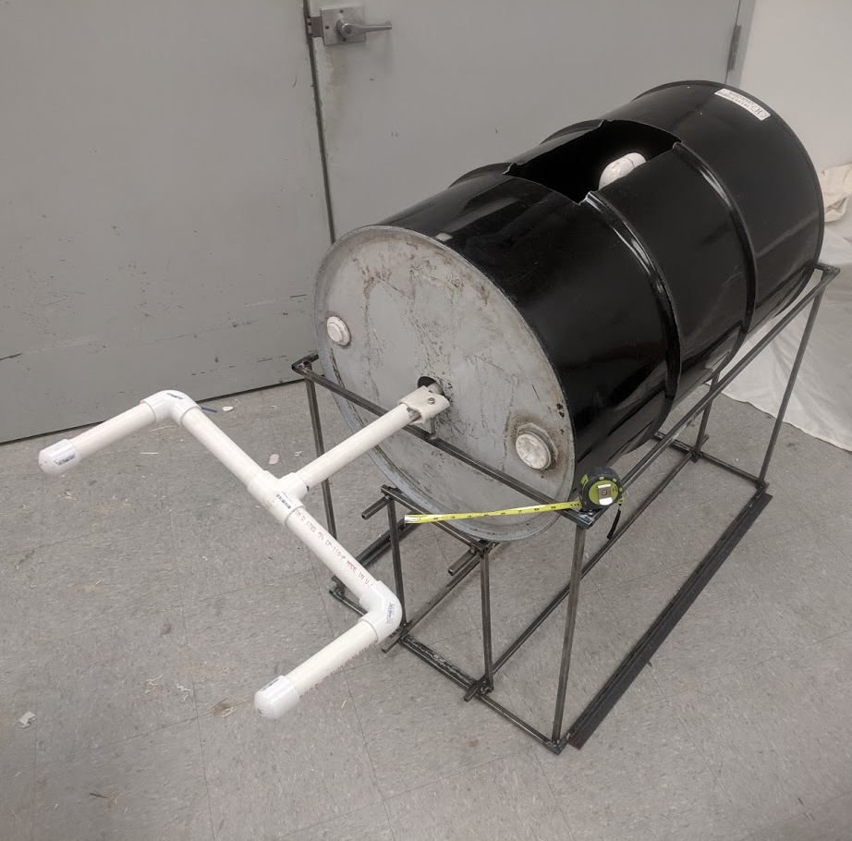
Team 10: Malawi Washing Machine
Team: Wesley Eidt, Jake Erwin, Bradley Franks, Ryan Kinkade, and Kyle Wilson
Advisors: Dr. Scott Thomas and Dr. Thomas Hangartner
Notes:
Ryan

Slide 2
Malawi
One of the world’s poorest countries
Landlocked
No electricity
No running water
Illiteracy
Oral Tradition
Notes:
Ryan

Slide 3
Design Constraints
Build a human-powered washing machine.
Needs to use materials readily available in Malawi.
Easy to build and communicate.
Notes:
Ryan

Slide 4
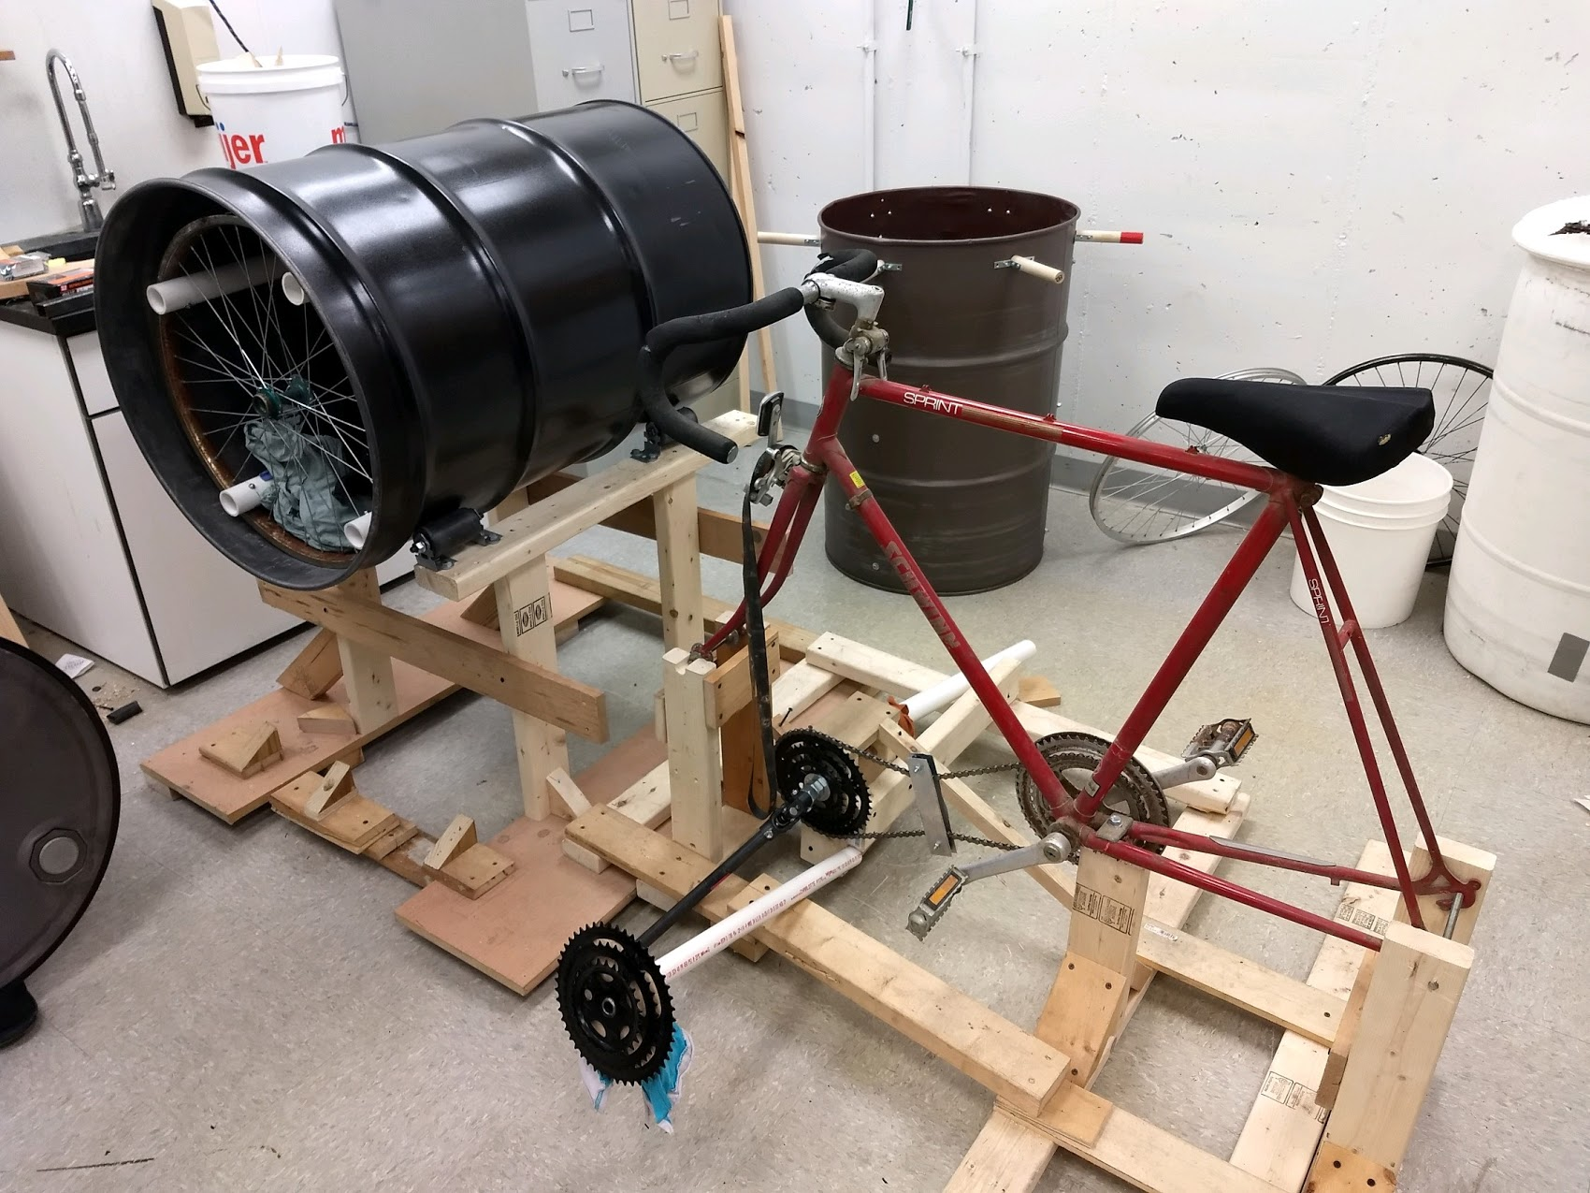
Previous Designs
Two previous designs
2017 design:
Bike power
Tilted barrel
Rotating agitator
2018 design:
Complex frame
Distributed torques
Rotating agitator
Design from 2017 Team
Design from 2018 Team
Notes:
Ryan

Slide 5
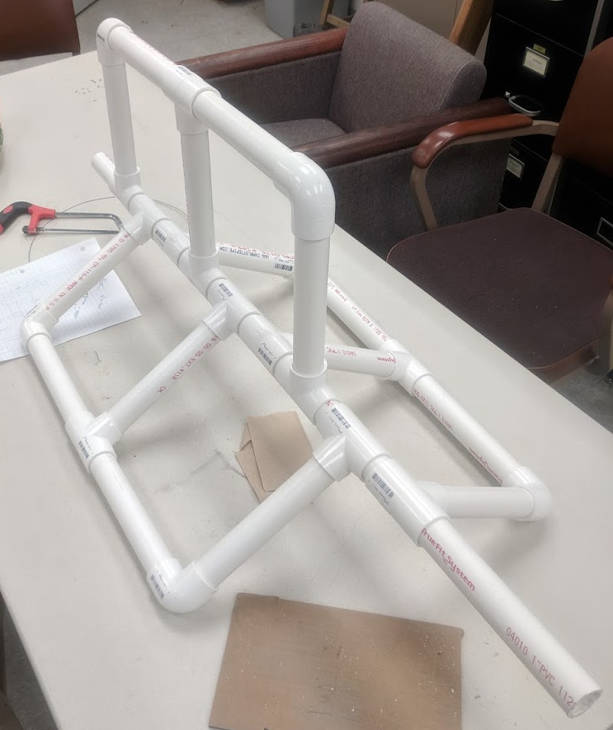
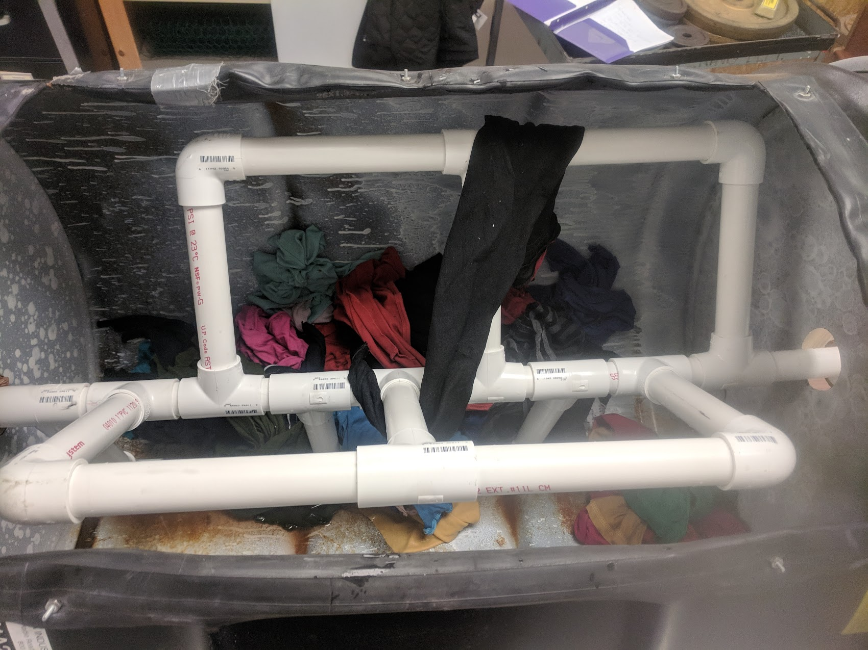
Agitation
Similar to previous design.
Central shaft
Fins radiate
Different fin orientations
Different fin numbers
Single, double, and triple
Each tested for agitation quality and difficulty of use.
Notes:
Bradley

Slide 6
Agitation
Mono-fin, Bi-fin, and Tri-fin
Bi-fin showed best performance
Easiest assembly for highest effectiveness
Agitator Comparisons
Fin | Mono-Fin | Bi-Fin | Tri-Fin
Agitation | 3 | 8 | 10
Ease of Construction | 10 | 9 | 3
Weight | 10 | 9 | 4
Communicability | 10 | 8 | 2
Total | 33 | 34 | 19
Notes:
Bradley

Slide 7
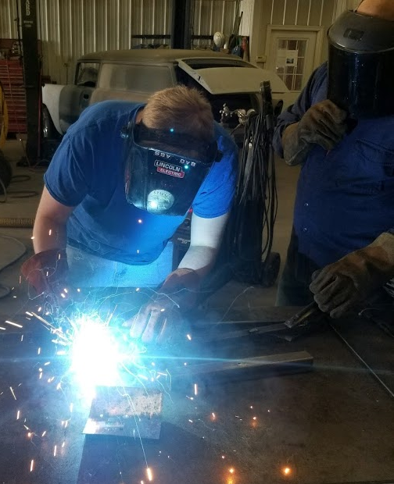
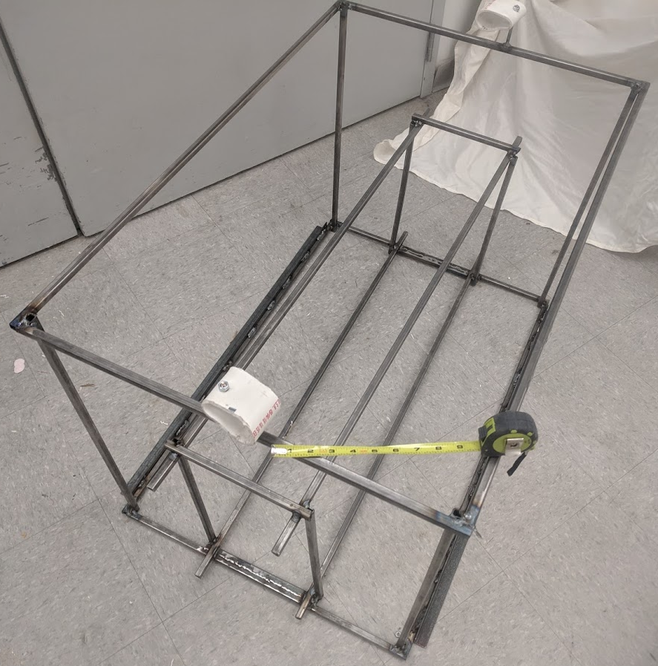
Frame
Test frame
Made from wooden planks.
Simple to build and adjust.
Served as a convenient placeholder.
Final metal frame
Welded from ½" steel tubing.
Allows for variable tube lengths / dimensions.
Sized to hold either plastic or metal barrel.
Notes:
Wes

Slide 8
Bearings
Support central shaft
Allow for low friction rotation.
Prevent metal on PVC contact.
Attach to metal frame and prevent excess shaft movement.
Boiling PVC
Made from a larger-diameter PVC pipe than the shaft.
Shape large pipe around the smaller during construction.
Notes:
Wes

Slide 9
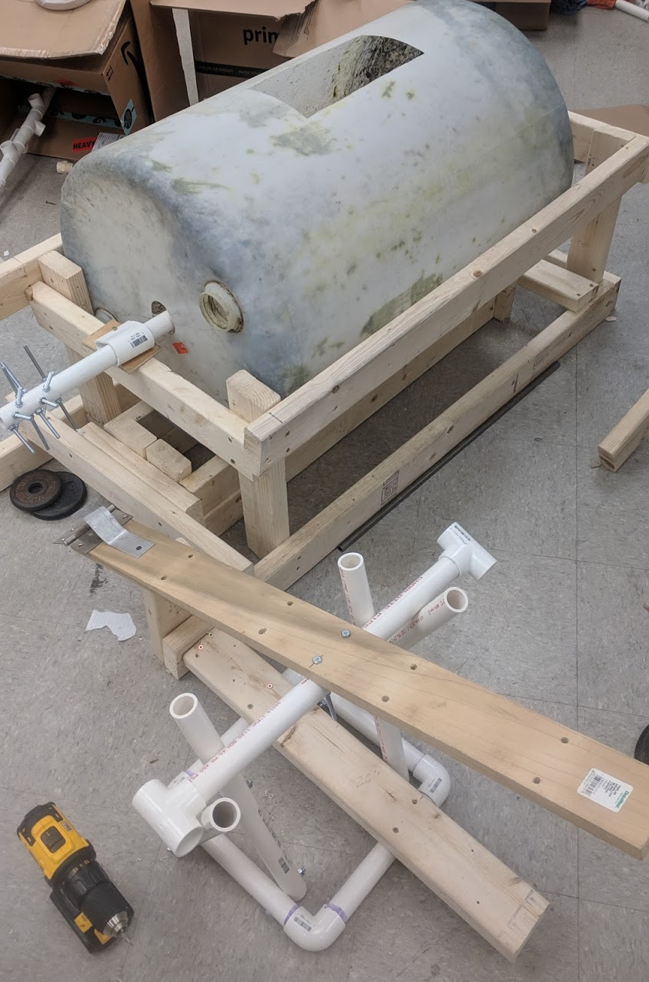
Stepper
Lever pushed by operator
Impacts ratchet to spin shaft and agitator.
Requires separate frame to hold lever.
Rotates on PVC axle.
Fixed to frame to maintain alignment.
Notes:
Jake

Slide 10
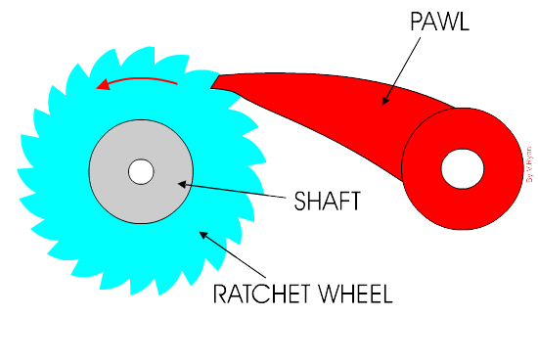
Ratchet and Pawl
Transmission
Translates user's input to spinning of agitator.
Locks rotation to one direction.
Driving pawl and locking pawl
Manufacturability
Must be created from materials available.
Teeth must be straight.
Notes:
Jake

Slide 11
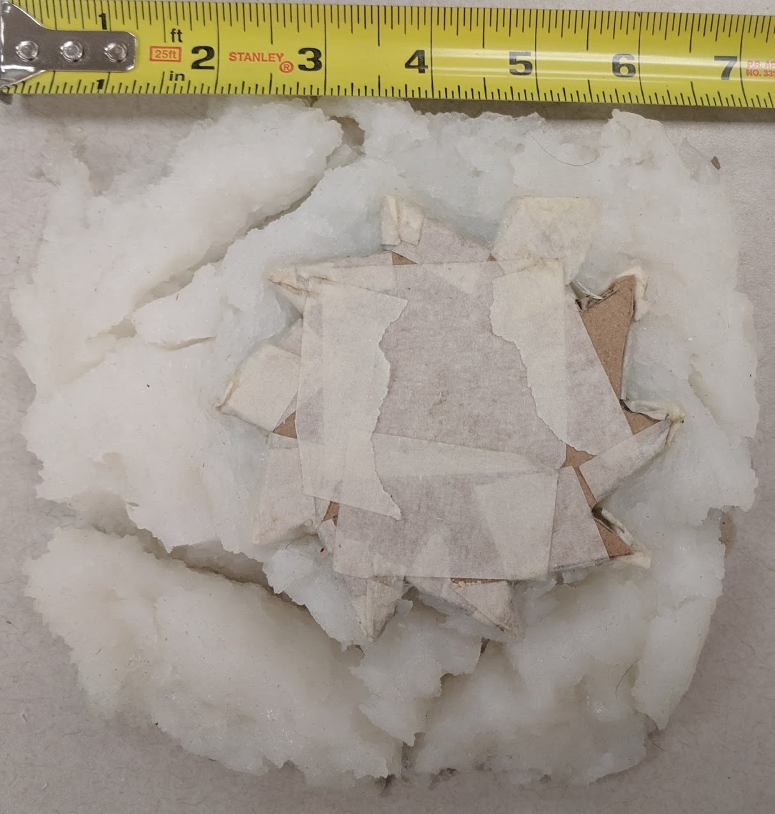
Molds
In order to create a concrete gear, we needed a precise mold.
Molds were developed to make a ratchet.
Attempted molds with Bondo, cornstarch, soap, and silicone.
Never able to achieve an ideal formula.
Some molds did not set.
Others did not show definition.
Notes:
Wes

Slide 12
Ratchet
After trouble with molding, an alternative was developed.
Updated design created using threaded rods.
Rods serve as teeth.
New problems
Difficulty with nut security
Difficulty with rod alignment
Stepper-ratchet system had flaws.
Difficulty delivering force
Poor retention of momentum
Notes:
Jake

Slide 13
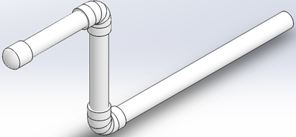
Hand Crank
Hand Crank designed to apply direct power.
Variety of designs.
Low required input torque (approximately 4 to 9 ft-lbs)
Notes:
Jake

Slide 14
Assembly
Hand-crank agitator effectively washes clothes.
Handles can be simply constructed and substituted for user preference.
"Simpler is better."
Easy to obtain parts, construct, and communicate.
Notes:
Kyle

Slide 15
Budget
Total Funds | $1,000.00
Total Expenses | $554.78
Remaining Funds | $445.22
Total cost of barrel design:
$231.10
Cost of manufacturing frame:
$72.00
Expenses by Category | Cost
Agitator | $135.89
Mold Testing | $108.18
Frame | $130.28
Equipment and Misc. | $70.43
Notes:
Kyle

Slide 16
Acknowledgements
A special thanks to Dr. Lynn Rogers and Dr. Bill Wollenhaupt for the donation of a plastic barrel and a great amount of advice. Thanks to the Hangartner’s for their advice and information that they provided. Thanks to Mike Erwin for the use of his welding equipment. Thanks to Kevin Eidt for creating custom metal pieces for the project. And a thank you to Marcus Acton for the donation of a metal barrel. Without the help of these individuals, it would have been very difficult to complete this project.
Notes:
Kyle

Slide 17
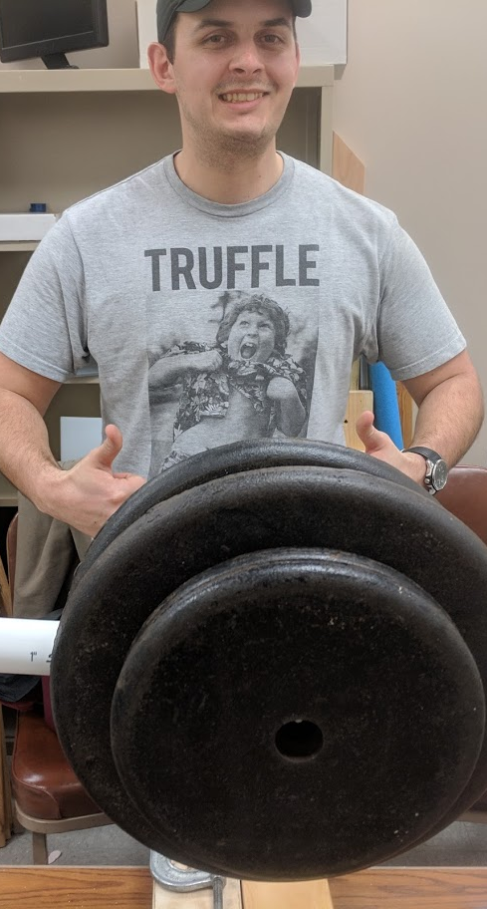
Questions?
Notes:
Kyle

Slide 18
References
http://www.technologystudent.com/cams/ratch1.htm
http://www.notesandsketches.co.uk/Ratchet.html
https://upload.wikimedia.org/wikipedia/commons/4/46/Malawi_map.png
http://www.technologystudent.com/cams/ratch1.htm
Grey, R., Hatton, N., Kosey, K., Lippolis, R. and Salchak, S. (2017). Washing Machine. [image].
Moussa, H., Purvis, J. and Spencer, Z. (2018). Washing Machine. [image].

