Slide 1
DC Motors
Types:
Continuous Rotation
Servo (Remote Control)
Stepper (Bipolar, Unipolar, Universal)
Ratings: Volts, Amps, RMP, Stall Current, Torque
Torque: 1 ft lb = 192 oz in
1 oz in = 72 gm cm
1 Nm = 10,200 gm cm
1 ft lb = 1.356 Nm = 13,825 gm cm

Slide 2
DC Motors (Continuous)
1.5 VDC to 24 & 48 VDC
3000 - 8000 RPM
<50% rated voltage (no rotation)
>130% rated voltage (over heating)
Speed Control - Pulse Width Modulation
Direction Control - Reverse Polarity

Slide 3
DC Motors (Servo)
Remote Control via Pulse Width Modulation
Partial Rotation (180° - 210°)
PMW
1.0 ms Pulse = Left Rotation
1.5 ms Pulse = Neutral
2.0 ms Pulse = Right Rotation

Slide 4
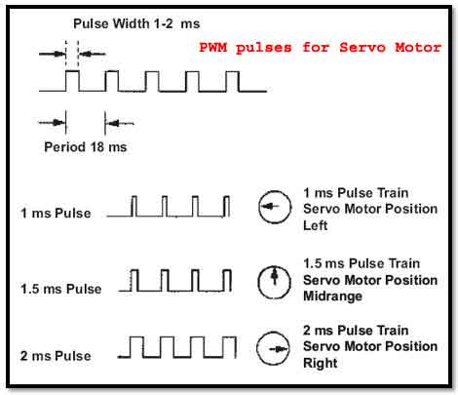
Servo Motors
https://en.wikipedia.org/wiki/Servomotor
https://en.wikipedia.org/wiki/Servo_%28radio_control%29
http://pcbheaven.com/wikipages/How_RC_Servos_Works/
Arduino and 28BYJ-48 Stepper Motor and ULN2003 Driver Intro (Bret Stateham)
https://www.youtube.com/watch?v=B86nqDRskVU
http://www.instructables.com/id/Arduino-Library-for-28BYJ-48-Stepper-Motor-and-ULN/

Slide 5
DC Motors (Stepper)
Variable Reluctance (free rotation)
n Phases = n Coils = 2n Poles
Permanent Magnet (cog/detent resistance)
Bipolar
Unipolar
Universal

Slide 6
Variable Reluctance Steppers
n Coils = n Phases = 2n Poles
One end of each coil connected to Common
Common connected to Power Supply
Each n phase lead grounded in turn
i.e. grounding the phase lead applies current to the circuit

Slide 7
Permanent Magnet Steppers
Leads Type
4 wire Bipolar (no center-tap)
5 wire Unipolar common center-tap
6 wire Unipolar individual center-tap
8 wire Universal (Bipolar / Unipolar)

Slide 8
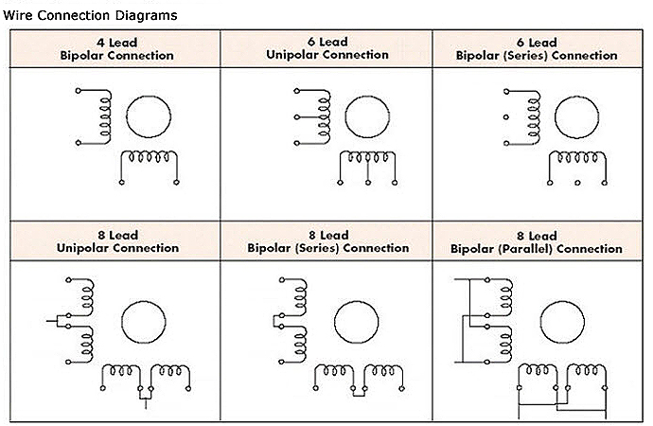
Universal Stepper Motor
4 Independent Coils (8 wires)
Coils wired in parallel = Unipolar
Coils wired in series = Bipolar

Slide 9
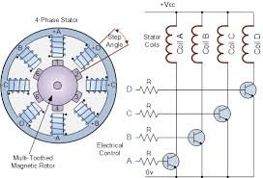
Bipolar Stepper Motor
Two phase (4 wires)
Not center-tapped
Each coil individually energized
Reverses polarity (hence the term “bipolar”)
More complex control circuits
Requires H-Bridge for every coil
More torque per unit size

Slide 10
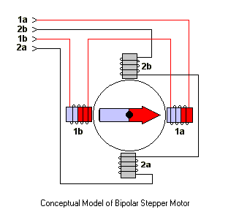
Bipolar Stepper Motor

Slide 11
Unipolar Stepper Motor
Center-Tapped
Internal Common (5 wire)
Separate Commons (6 wire)
Connect Center-Tap(s) to +VDC Power supply
Ground Phase Leads via Control Pulses in turn
Full Stepping
Half Stepping
Power Stepping
Requires 2 power
Provides 1.44 torque

Slide 12
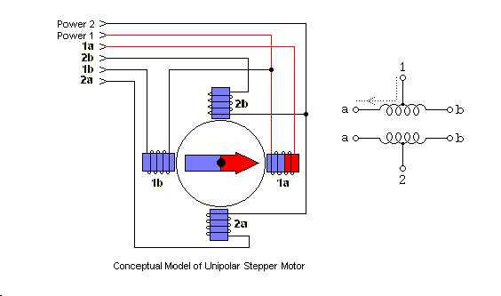
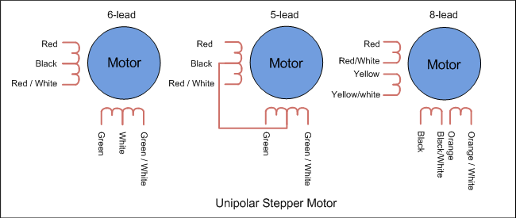
Unipolar Stepper Motor

