Slide 1
Word Embedding Explained
and Visualized : ADAPTED
Xin Rong
School of Information
University of Michigan
(Edits by t.k.prasad@wright.edu)
Notes:
Dictionary
Independent Term Axes (One hot vector representation)
Term row vectors from term-document matrix (long + corpus specific)
LSI – dimensional reduction to latent space (shorter, better due to contextual disambiguation)
Word-embedding : distributional semantics : A word is known by the company it keeps
word2vec : embeddings are superposition of all senses
BERT, … : contextual embeddings

Slide 2
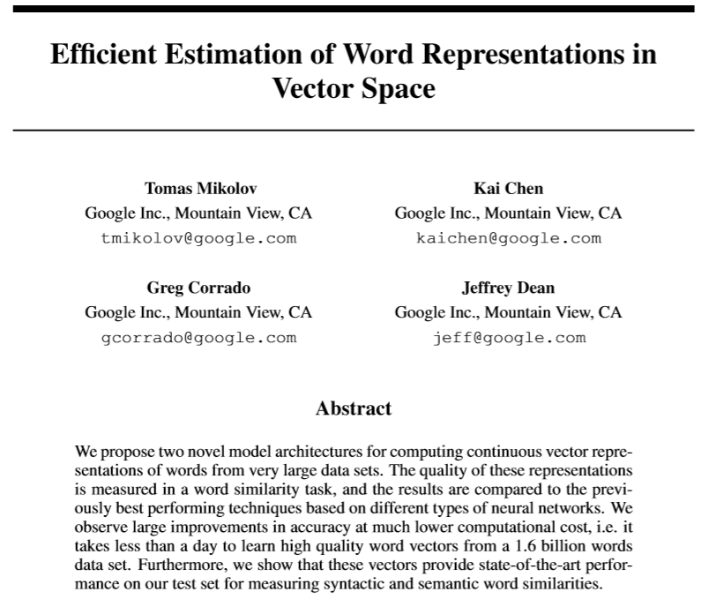
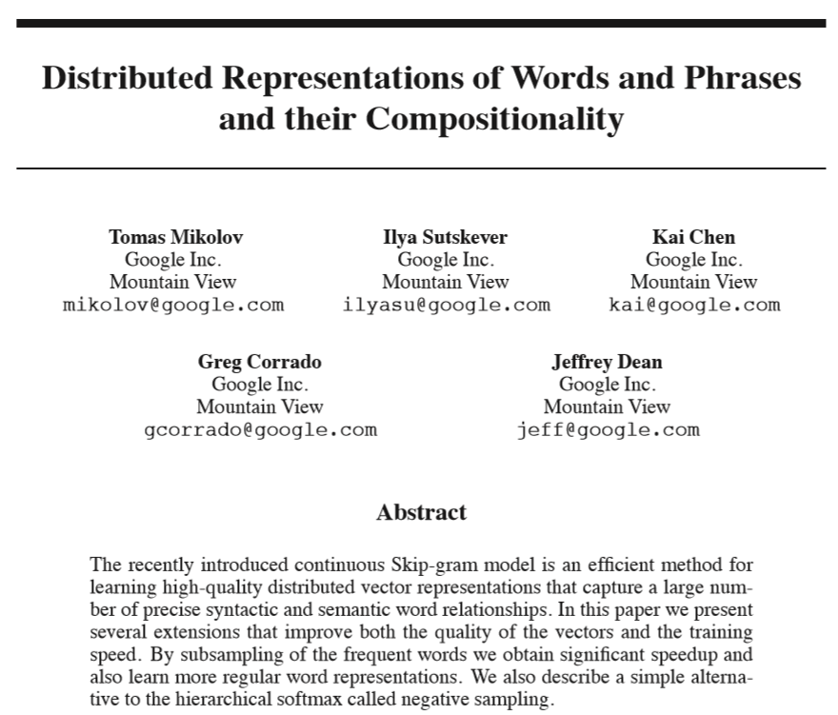
About word2vec...
Two original papers published in association with word2vec by Mikolov et al. (2013)

Slide 3
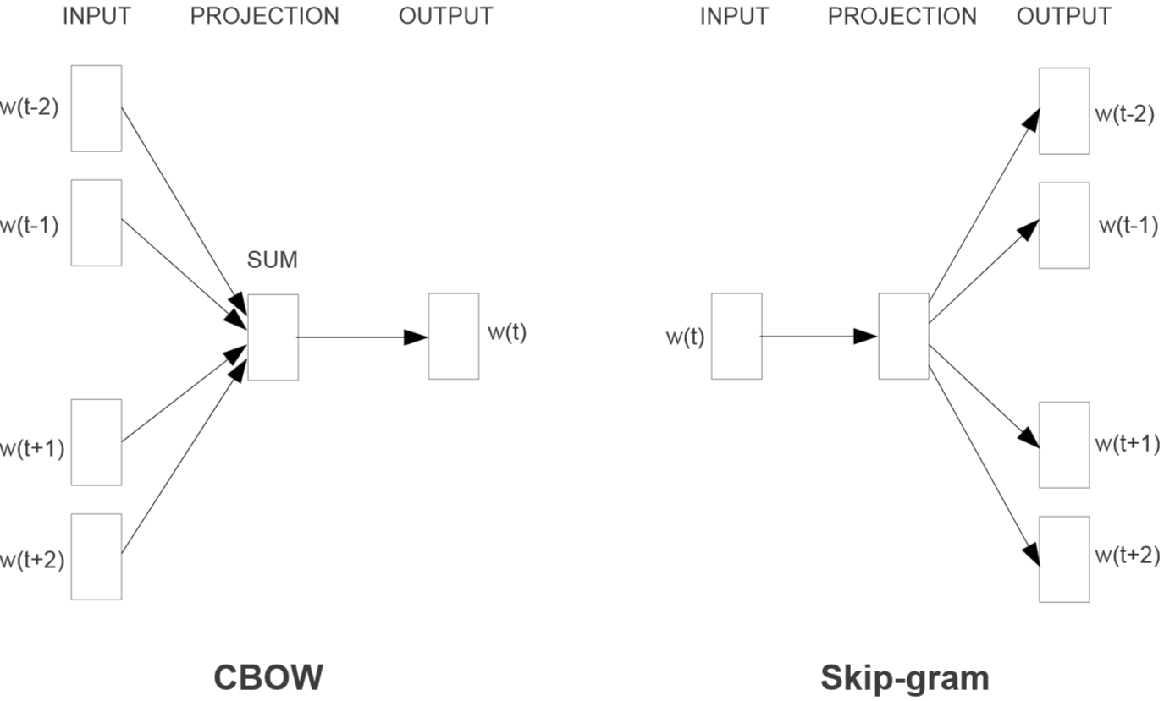

Slide 4
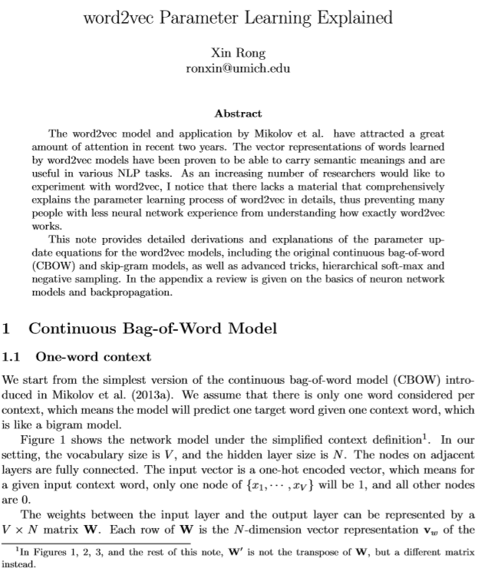
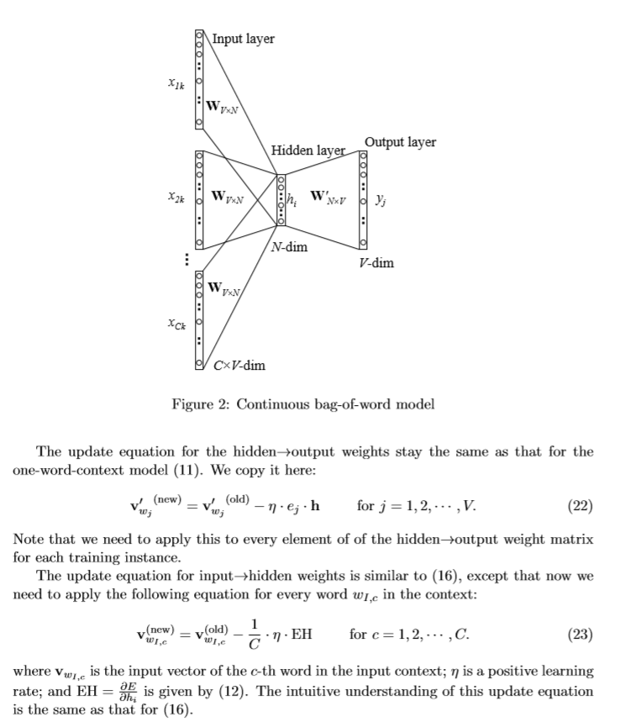

Slide 5
Source code: github.com/ronxin/wevi
Online demo: ronxin.github.io/wevi

Slide 6
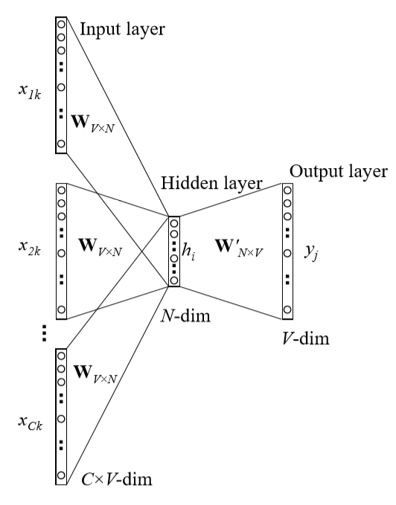
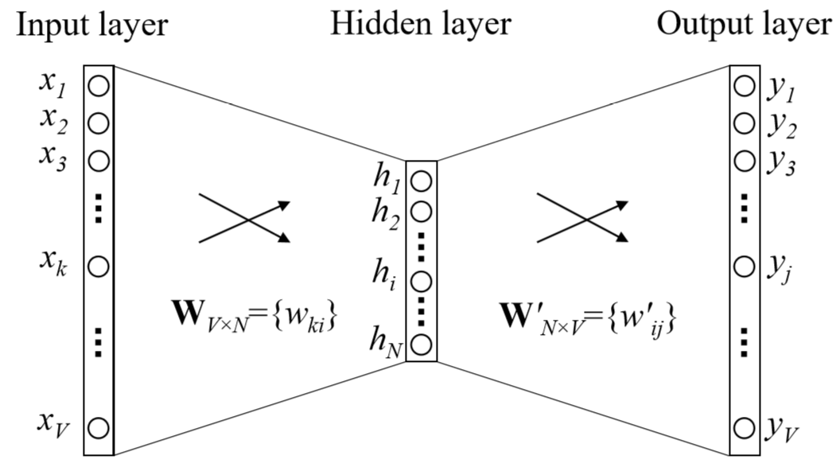
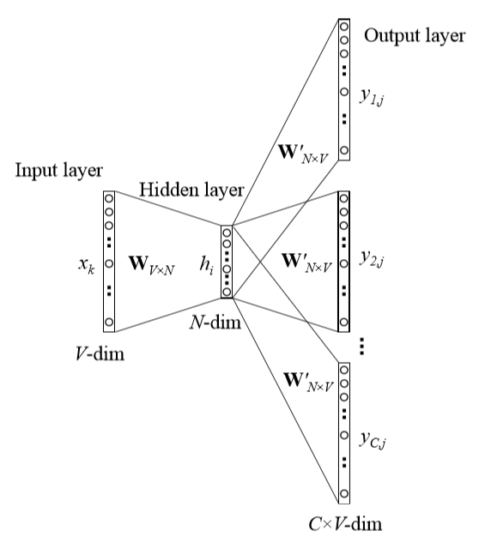
CBOW
word2vec model architecture
Skip-gram

Slide 7
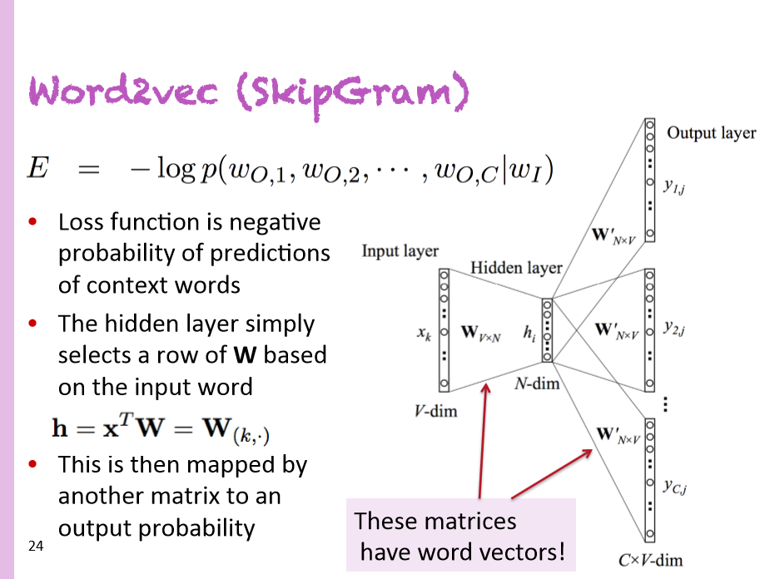
Christopher Manning
Deep Learning Summer School (2015)

Slide 8
Atomic Word Representation
Word is represented by identity
apple
[0 0 0 0 0 1 0 0 0 0 0 0 0 0 0 0 0 0 ... 0 0 0 0 0 0]
orange
[0 0 0 0 0 0 0 0 0 0 0 0 0 1 0 0 0 0 ... 0 0 0 0 0 0]
car
[0 0 0 0 0 0 0 1 0 0 0 0 0 0 0 0 0 0 ... 0 0 0 0 0 0]
apple juice
_____ juice
?
But, the dot product, apple . orange = 0
I.e., one-hot vector representation does not capture the semantics of the words adequately.
Notes:
Need representation learning

Slide 9

Distributed Representation
Word is represented as continuous level of activations
apple
orange
car
inhibited
excited
Notes:
Embeddings are an array of real numbers.
Typical sizes: 100, 256, 512, 1024.
BERT: 768 real numbers
GPT-3: 12288 = 3 * 2^12

Slide 10
Vector-Space Model vs LSI
Rows in the term document matrix can be used as representation of the terms – uses the distribution of the terms in the document corpus
In latent semantic analysis, the terms (and the documents) are represented in the reduced latent vector space using singular value decomposition, to better capture their semantics.

Slide 11
Contextual Representation : Capturing usage
Word is represented by context in use
I eat an apple every day.
I eat an orange every day.
I like driving my car to work.
What represents the meanings of a word?
“You shall know a word by the company it keeps” – J.R. Firth, 1957
Notes:
Semantics defined by substitutivity
Red and Blue are opposites in some context
But can be substituted in many sentences
So will have “similar” word-embeddings.

Slide 12
Word Embeddings : Goals
Assign each word a vector such that
similar words have similar vectors (by dot-product).
Embedding vectors are usually
    ◦ short (length 50-1000)
    ◦ dense (most elements are non-zero)
    Very fast to train
    Idea: predict rather than count

Slide 13
Sparse versus dense vectors
Why dense vectors?
◦ Short vectors easier to use as features in machine
learning (less weights to tune)
◦ Dense vectors generalize better than storing explicit
counts (because they encode semantic information)
◦ “Embeddings” do better at capturing synonymy:
◦ car and automobile are synonyms; but are distinct dimensions
◦ a word with car as a neighbor and a word with automobile as
a neighbor should be similar, but aren't
◦In practice, they work better

Slide 14
(Projected) Word Vectors
juice
apple
orange
banana
rice
milk
bus
car
train

Slide 15
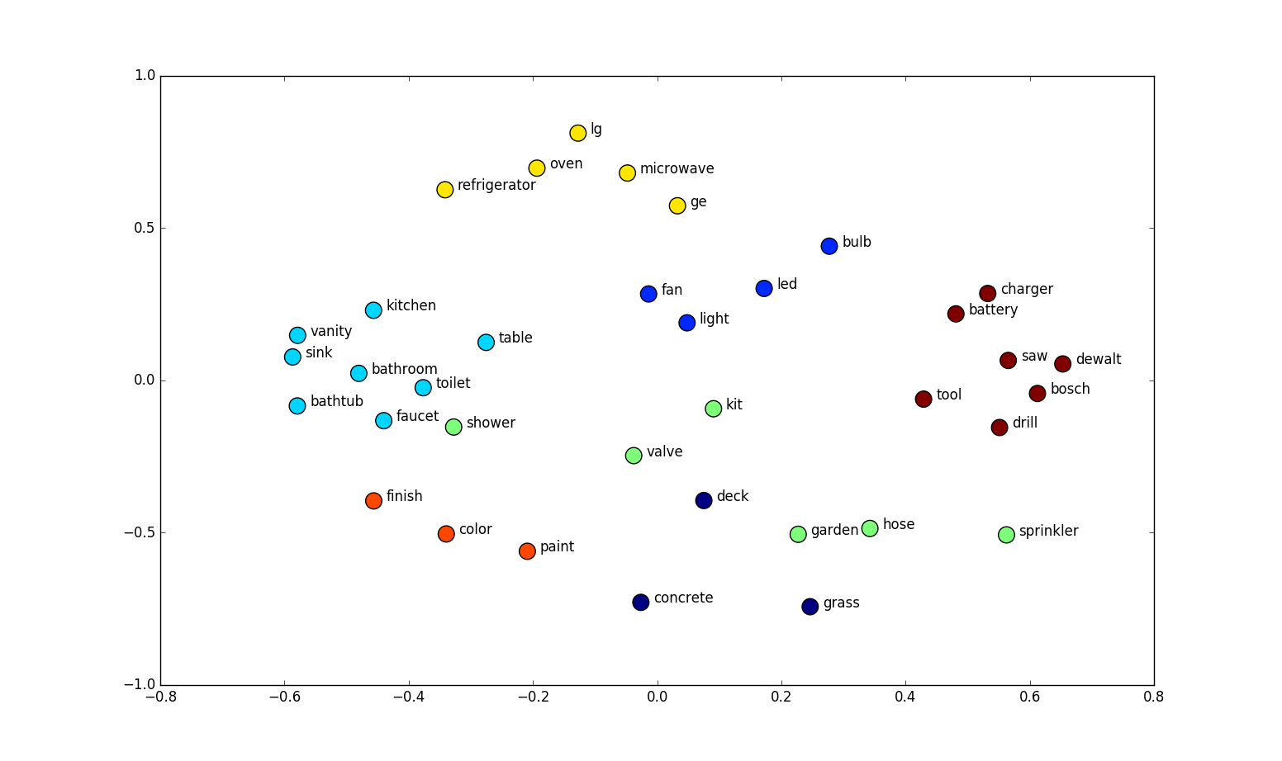
Word embeddings projected onto 2D (t-SNE?)
01
Word2Vec

Slide 16
Word Analogy
king
queen
uncle
aunt
man
woman
Mikolov & Chen et al. 2013
Mikolov & Sutskever et al. 2013

Slide 17
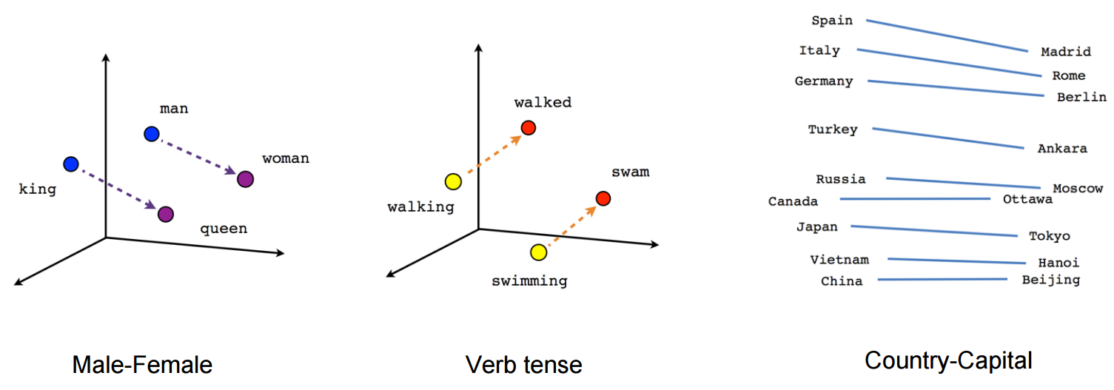
Word embeddings preserve relationships
01
Word2Vec

Slide 18
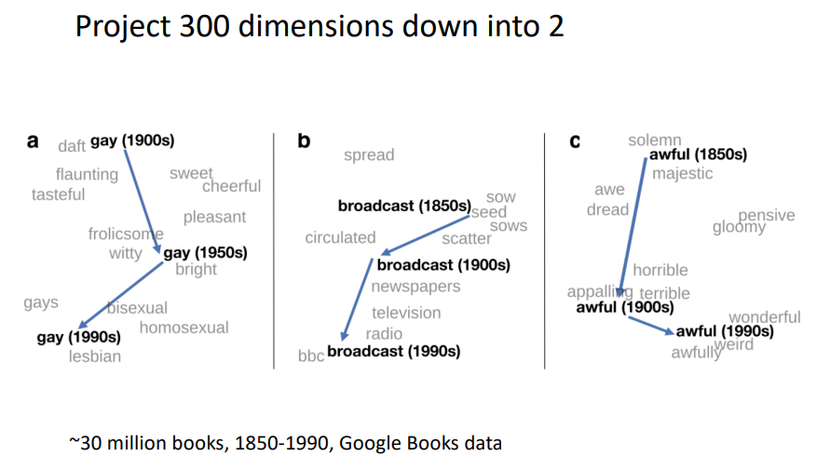
Visualizing “meaning” changes : Reflecting biases

Slide 19
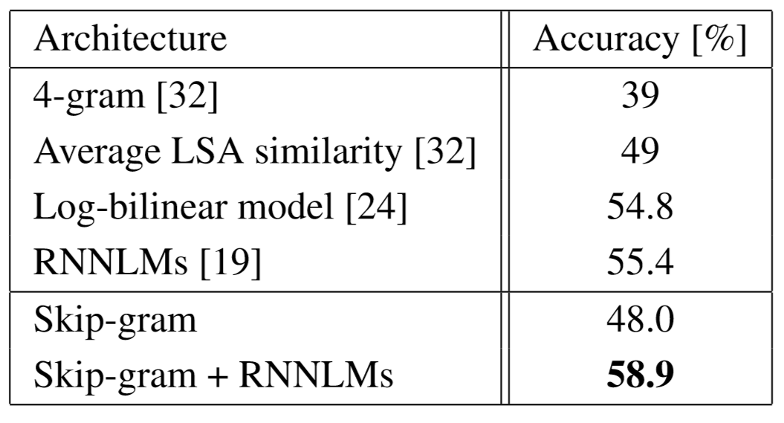
Applications benefited by word embeddings
Dependency parsing
Named entity recognition
Document classification
Sentiment Analysis
Paraphrase Detection
Word Clustering
Machine Translation
Table 7: Comparison and combination of models on the Microsoft Sentence Completion Challenge
"Efficient estimation of word representations in vector space" Mikolov & Chen et al. 2013

Slide 20

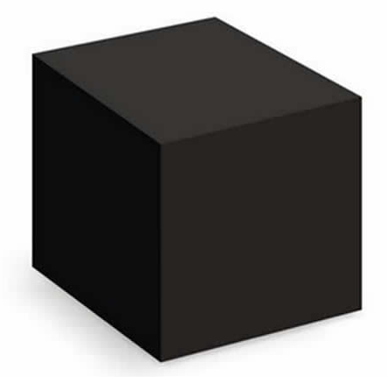
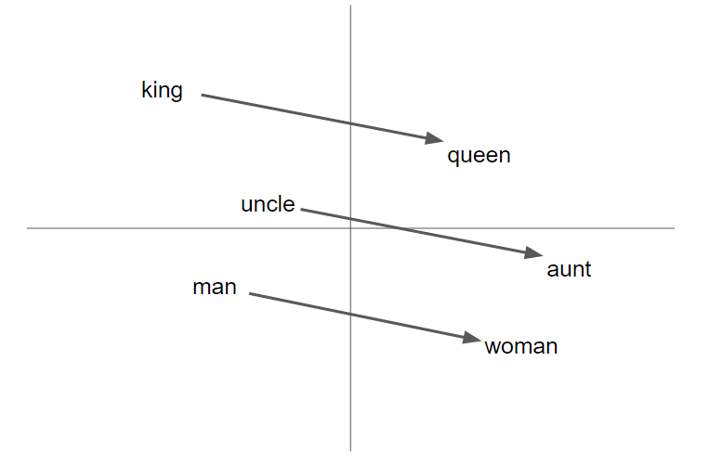
word2vec as a (powerful) black box
word2vec
Wikipedia
Unsupervised learning instance

Slide 21
word2vec decomposed
Input Corpus
Vocabulary
Builder
Lossy Counting
Vocabulary
Sentence Windows
Context Builder
Dynamic Window Scaling
Subsampling
Pruning
CBOW
Skip-gram
Input
Words
Output
Words
Vectors
(Final Product)
Parameter Learner
Backpropagation
Hierarchical Softmax
Negative Sampling

Slide 22
wevi
demo
bit.ly/wevi-online

Slide 23
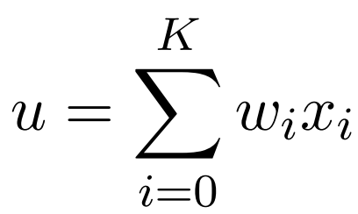
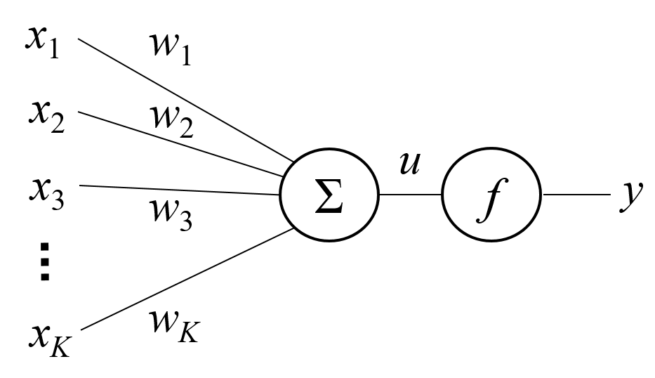
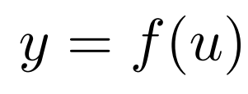
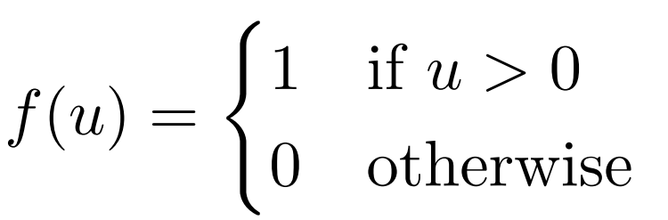
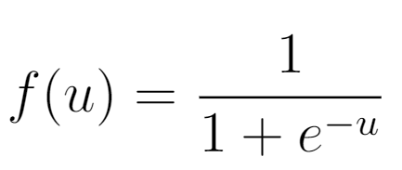
Basic Neuron Structure
a neuron

Slide 24
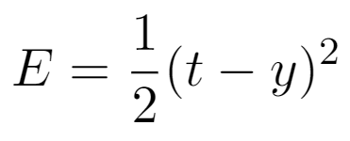
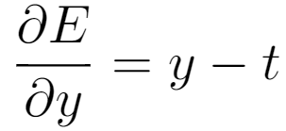
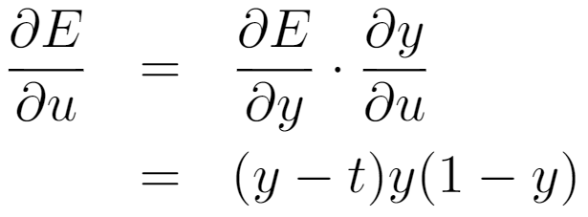
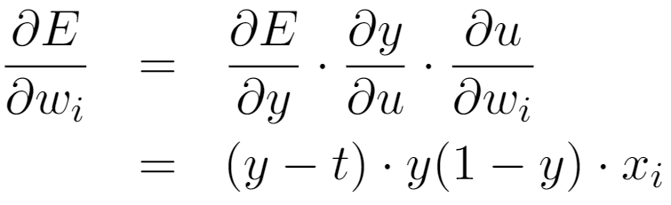
Training a Single Neuron
x
t
a neuron

Slide 25
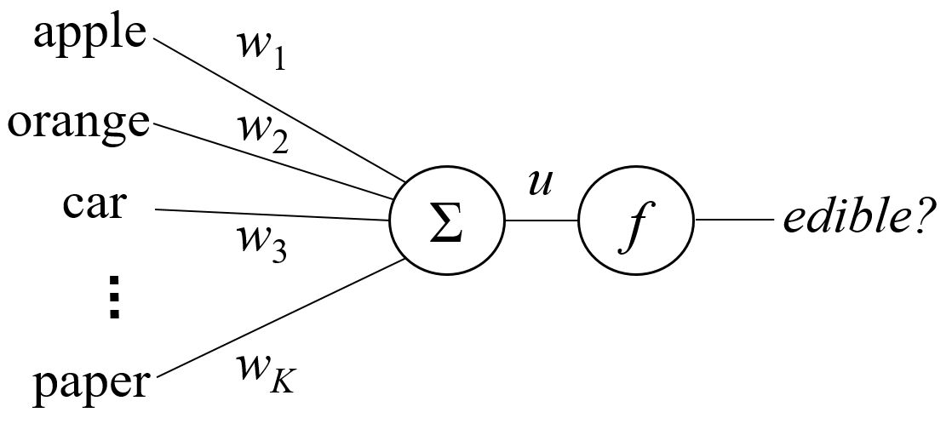
Task Afforded by a Single Neuron
A lookup table
Item | Edible?
apple | Y
orange | Y
car | N
... | ...
paper | N

Slide 26
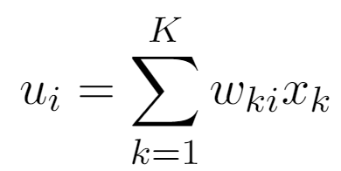
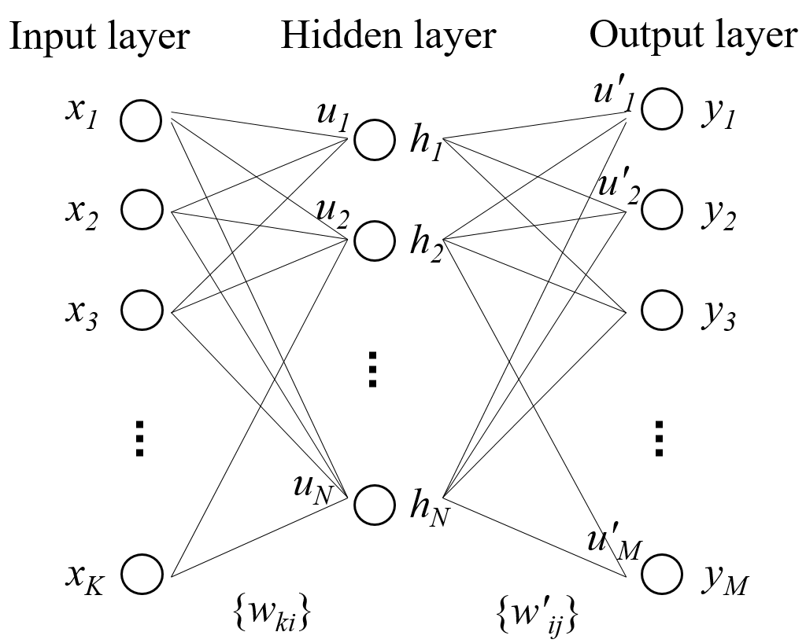

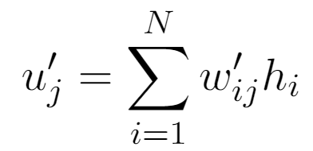

Multilayer Neural Network

Slide 27
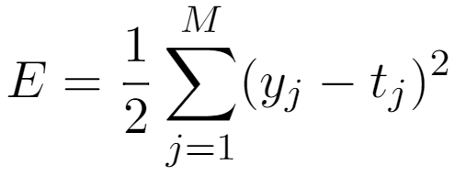
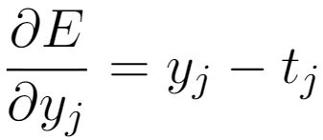
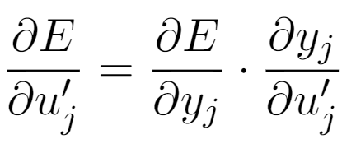
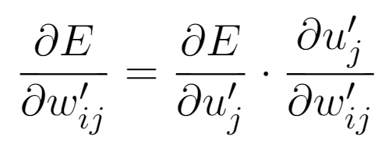
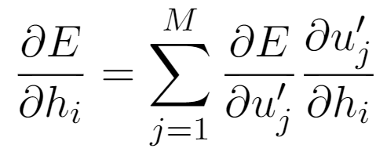
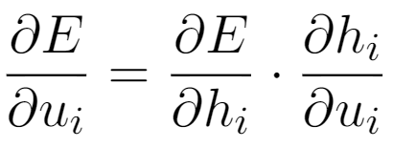
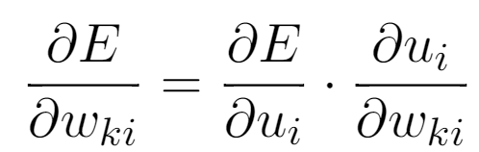
Backpropagation
x
t

Slide 28
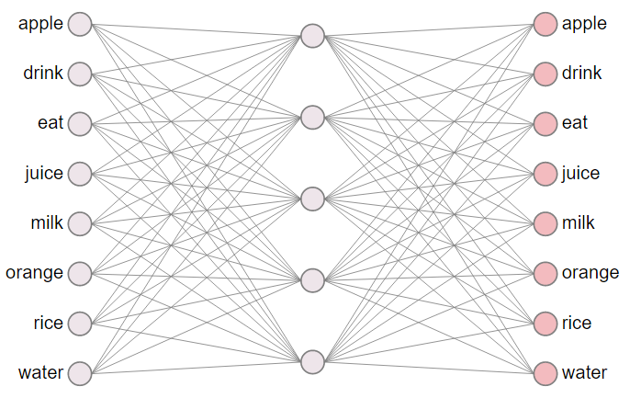
word2vec network
Structure Highlights:
input layer
  one-hot vector
hidden layer
  linear (identity)
output layer
  softmax

Slide 29
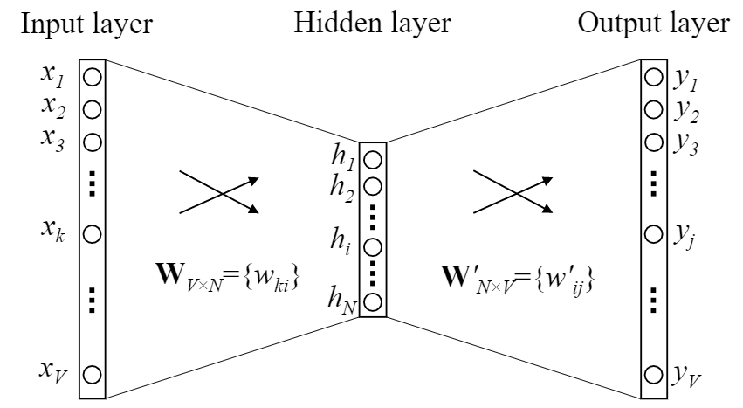
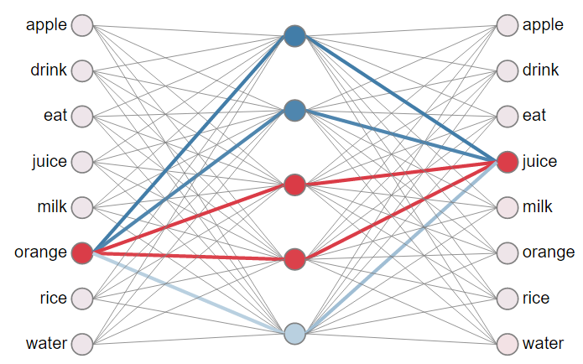

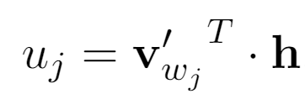
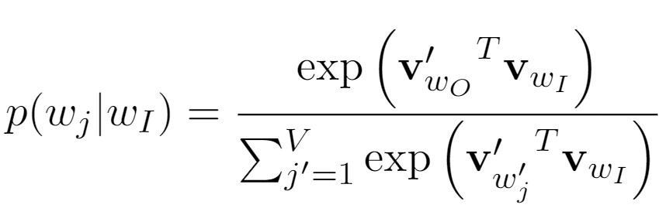
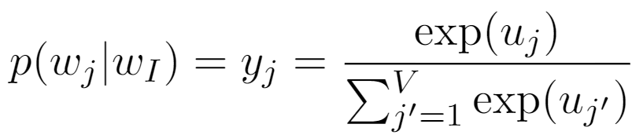
word2vec network

Slide 30
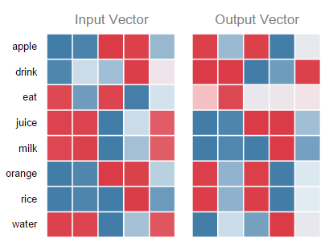
neural network and weight matrices

Slide 31
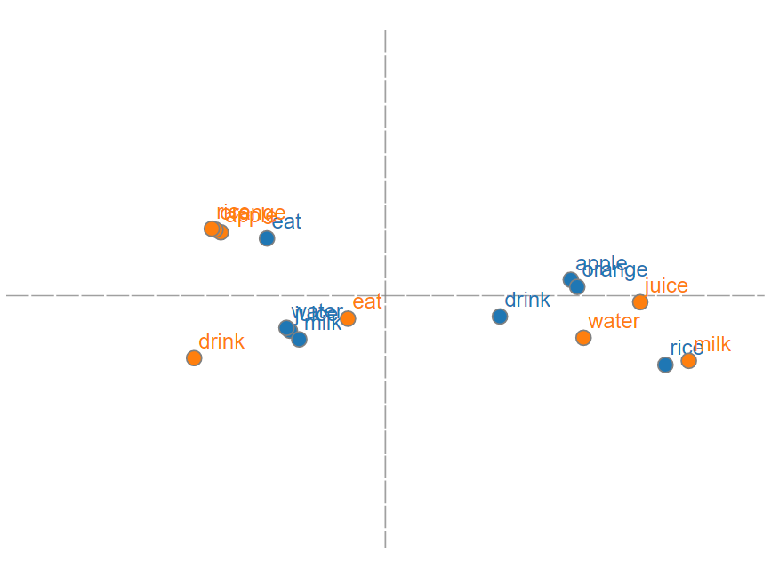
neural network and word vectors

Slide 32
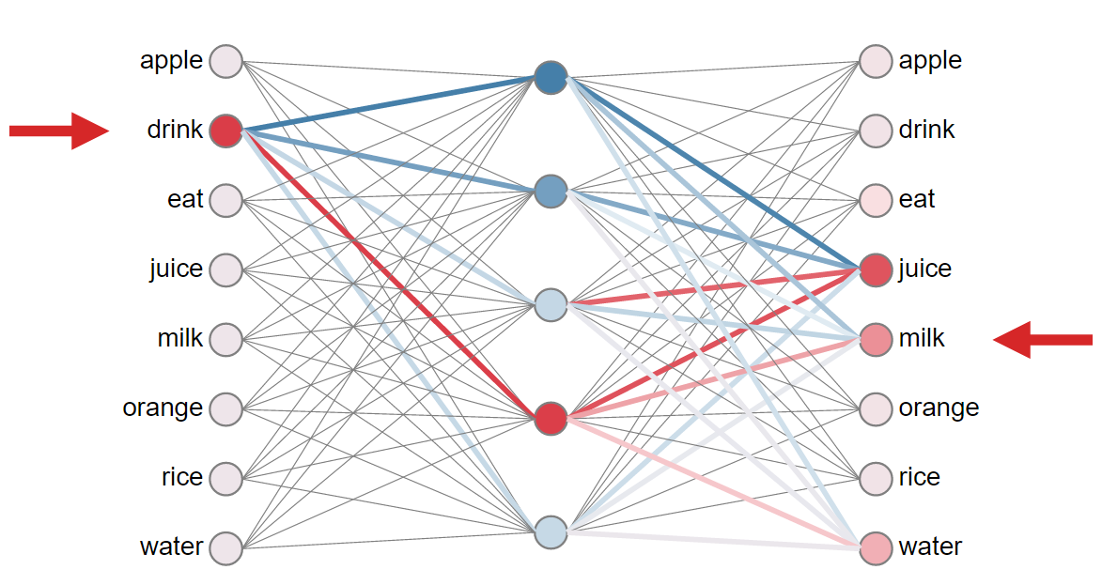
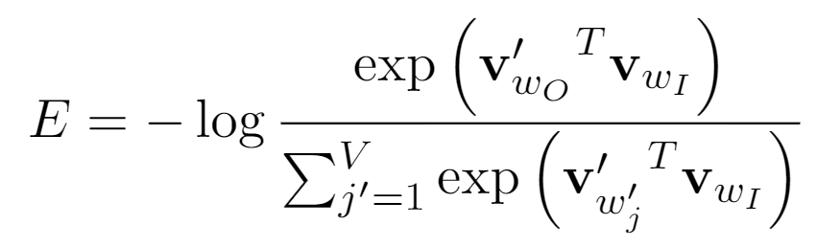
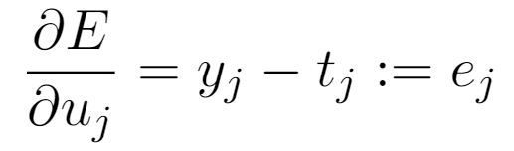
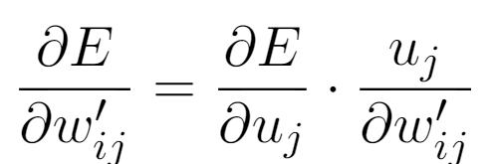
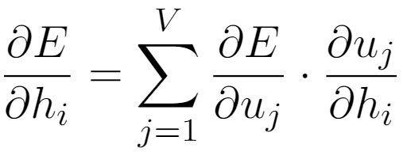
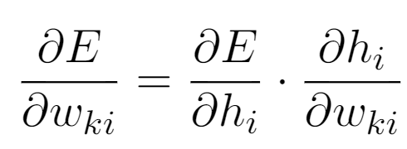
Training: updating word vectors

Slide 33
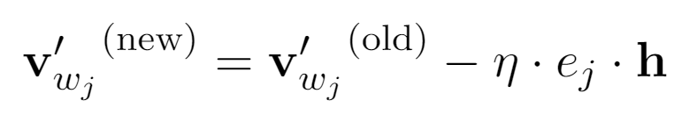

Intuition of output vector update rule

Slide 34


Intuitive Understanding of Input Vectors

Slide 35

Resemblance to a force-directed graph
equilibrium length ~ - strength of co-occurrence
more on this later...

Slide 36
word2vec decomposed
Input Corpus
Vocabulary
Builder
Lossy Counting
Vocabulary
Sentence Windows
Context Builder
Dynamic Window Scaling
Subsampling
Pruning
CBOW
Skip-gram
Input
Words
Output
Words
Vectors
(Final Product)
Parameter Learner
Backpropagation
Hierarchical Softmax
Negative Sampling

Slide 37
How do we select input and output words?
Method 1: continuous bag-of-word (CBOW)
eat an apple every day
Method 2: skip-gram (SG)
eat an apple every day

Slide 38
wevi
demo
(CBOW and SG)

Slide 39

word2vec
Predict words using context
Two versions: CBOW (continuous bag of words) and Skip-gram
https://skymind.ai/wiki/word2vec

Slide 40

CBOW
Bag of words
  Gets rid of word order. Used in discrete case using counts of words that appear.
CBOW
  Takes vector embeddings of n words before target and n words after and adds them (as vectors).
  Also removes word order, but the vector sum is meaningful enough to deduce missing word.

Slide 41

Word2vec – Continuous Bag of Word
E.g. “The cat sat on floor”
  Window size = 2
the
cat
sat
on
floor
www.cs.ucr.edu/~vagelis/classes/CS242/slides/word2vec.pptx

Slide 42

Input layer
Index of cat in vocabulary
0
1
0
cat
0
Hidden layer
Output layer
0
0
0
0
0
0
…
0
0
0
one-hot
vector
0
sat
one-hot
vector
0
0
0
0
1
0
…
1
0
on
0
0
0
0
…
0
www.cs.ucr.edu/~vagelis/classes/CS242/slides/word2vec.pptx

Slide 43
We must learn W and W’
Input layer
0
1
0
cat
0
$$W_{V×N}$$
Hidden layer
Output layer
0
0
0
0
0
0
V-dim
…
0
0
$${W′}_{N×V}$$
0
0
sat
0
0
0
0
1
0
$$W_{V×N}$$
N-dim
…
V-dim
1
0
on
0
0
0
0
V-dim
…
N will be the size of word vector
0
www.cs.ucr.edu/~vagelis/classes/CS242/slides/word2vec.pptx

Slide 44
$$W_{V×N}^{T} ×x_{cat}=v_{cat}$$
0.1 | 2.4 | 1.6 | 1.8 | 0.5 | 0.9 | … | … | … | 3.2
0.5 | 2.6 | 1.4 | 2.9 | 1.5 | 3.6 | … | … | … | 6.1
… | … | … | … | … | … | … | … | … | …
… | … | … | … | … | … | … | … | … | …
0.6 | 1.8 | 2.7 | 1.9 | 2.4 | 2.0 | … | … | … | 1.2
0
2.4
2.6
…
…
1.8
Input layer
1
$$×$$
0
$$=$$
0
0
1
0
0
0
x_{cat}
0
0
Output layer
0
0
0
$$W_{V×N}^{T}×x_{cat}=v_{cat}$$
…
0
0
0
0
0
V-dim
…
0
0
$$\hat{v}=\frac{v_{cat}+v_{on}}{2}$$
0
+
0
sat
0
0
0
0
$$W_{V×N}^{T}×x_{on}=v_{on}$$
1
0
…
V-dim
1
Hidden layer
0
x_{on}
0
0
N-dim
0
0
V-dim
…
0
www.cs.ucr.edu/~vagelis/classes/CS242/slides/word2vec.pptx

Slide 45
$$W_{V×N}^{T} ×x_{on}=v_{on}$$
0.1 | 2.4 | 1.6 | 1.8 | 0.5 | 0.9 | … | … | … | 3.2
0.5 | 2.6 | 1.4 | 2.9 | 1.5 | 3.6 | … | … | … | 6.1
… | … | … | … | … | … | … | … | … | …
… | … | … | … | … | … | … | … | … | …
0.6 | 1.8 | 2.7 | 1.9 | 2.4 | 2.0 | … | … | … | 1.2
0
1.8
2.9
…
…
1.9
Input layer
0
$$×$$
0
$$=$$
0
1
1
0
0
0
x_{cat}
0
0
Output layer
0
0
0
$$W_{V×N}^{T}×x_{cat}=v_{cat}$$
…
0
0
0
0
0
V-dim
…
0
0
$$\hat{v}=\frac{v_{cat}+v_{on}}{2}$$
0
+
0
sat
0
0
0
0
$$W_{V×N}^{T}×x_{on}=v_{on}$$
1
0
…
V-dim
1
Hidden layer
0
x_{on}
0
0
N-dim
0
0
V-dim
…
0
www.cs.ucr.edu/~vagelis/classes/CS242/slides/word2vec.pptx

Slide 46
Input layer
0
1
0
cat
0
$$W_{V×N}$$
Hidden layer
Output layer
0
0
0
0
0
0
V-dim
…
0
0
$$W_{V×N}^{′}×\hat{v}=z$$
0
$$\hat{y}=softmax(z)$$
0
0
0
0
0
$$\hat{v}$$
1
0
$$W_{V×N}$$
…
1
N-dim
0
on
0
${\hat{y}}_{sat}$
0
0
V-dim
0
V-dim
…
N will be the size of word vector
0
www.cs.ucr.edu/~vagelis/classes/CS242/slides/word2vec.pptx

Slide 47
Input layer
0
We would prefer $\hat{y}$ close to ${\hat{y}}_{sat}$
1
0
cat
0
$$W_{V×N}$$
Hidden layer
Output layer
0
0
0
0
0.01
0.02
0.00
0.02
0.01
0.02
0.01
0.7
…
0.00
0
0
V-dim
…
0
0
$$W_{V×N}^{′}×\hat{v}=z$$
$$\hat{y}=softmax(z)$$
0
0
0
0
0
0
$$\hat{v}$$
1
0
$$W_{V×N}$$
…
1
N-dim
0
on
0
${\hat{y}}_{sat}$
0
0
V-dim
0
V-dim
…
N will be the size of word vector
$\hat{y}$
0
www.cs.ucr.edu/~vagelis/classes/CS242/slides/word2vec.pptx

Slide 48
$$W_{V×N}^{T}$$
0.1 | 2.4 | 1.6 | 1.8 | 0.5 | 0.9 | … | … | … | 3.2
0.5 | 2.6 | 1.4 | 2.9 | 1.5 | 3.6 | … | … | … | 6.1
… | … | … | … | … | … | … | … | … | …
… | … | … | … | … | … | … | … | … | …
0.6 | 1.8 | 2.7 | 1.9 | 2.4 | 2.0 | … | … | … | 1.2
Contain word’s vectors
Input layer
0
1
0
x_{cat}
0
Output layer
0
0
$$W_{V×N}^{}$$
0
0
0
0
V-dim
…
0
0
$$W_{V×N}^{′}$$
0
0
sat
0
0
0
0
1
0
$$W_{V×N}^{}$$
…
1
0
V-dim
x_{on}
0
Hidden layer
0
N-dim
0
0
V-dim
…
0
We can consider either W or W’ as the word’s representation. Or even take the average.
www.cs.ucr.edu/~vagelis/classes/CS242/slides/word2vec.pptx
Notes:
W contains input word vectors.
W’ contains output word vectors.
We can consider either W or W’ as the word’s representation. Or even take the average.

Slide 49


Skip gram example
Vocabulary of 10,000 words.
Embedding vectors with 300 features.
So, the hidden layer is going to be represented by a weight matrix with 10,000 rows (multiply by vector on the left).
http://mccormickml.com/2016/04/19/word2vec-tutorial-the-skip-gram-model/

Slide 50
Skip gram/CBOW intuition
Similar “contexts” (that is, what words are likely to appear around them), lead to similar embeddings for two words.
One way for the network to output similar context predictions for these two words is if the word vectors are similar. So, if two words have similar contexts, then the network is motivated to learn similar word vectors for these two words!
http://mccormickml.com/2016/04/19/word2vec-tutorial-the-skip-gram-model/

Slide 51
word2vec decomposed
Input Corpus
Vocabulary
Builder
Lossy Counting
Vocabulary
Sentence Windows
Context Builder
Dynamic Window Scaling
Subsampling
Pruning
CBOW
Skip-gram
Input
Words
Output
Words
Vectors
(Final Product)
Parameter Learner
Backpropagation
Hierarchical Softmax
Negative Sampling

Slide 52
Training Generic Softmax is Intractable
need to update every single output vector!

Slide 53

Hierarchical Softmax

Slide 54
Negative Sampling

Slide 55
word2vec decomposed
Input Corpus
Vocabulary
Builder
Lossy Counting
Vocabulary
Sentence Windows
Context Builder
Dynamic Window Scaling
Subsampling
Pruning
CBOW
Skip-gram
Input
Words
Output
Words
Vectors
(Final Product)
Parameter Learner
Backpropagation
Hierarchical Softmax
Negative Sampling

Slide 56





Interpreting word embedding model
Coocurrence Matrix

Slide 57

Levy & Goldberg. "Neural word embedding as implicit matrix factorization." NIPS 2014.

Slide 58

Levy, Goldberg, and Dagan. ACL (2015)

Slide 59
Other neural embedding models
Bengio (2003)
Mnih & Hinton (2008)
Collobert & Weston (2008)
Minh et a. (2013)
GloVe by Pennington et al. (2014)
DeepWalk by Perozzi (2014)
LINE by Tang et al. (2015)

Slide 60


More on Word Analogy
Rohde, Gonnerman & Plaut (2005)
"An Improved Model of Semantic Similarity Based on Lexical Co-Occurrence"

Slide 61
wevi
demo
(word analogy)

Slide 62
"Miscellaneous" Embedding
Word -> Word
Alternative input/output setting:
User -> Tweet
Customer -> Product
Word -> Parse-tree Neighbors
Entity -> Neighbor in a list
Node -> Random walk path in a graph
Notes:
Commonality: cooccurrence and higher-order cooccurrence. Matrix factorization.

Slide 63
Limitations
Word ambiguity
Debuggability
Sequence
Notes:
Current model taking advantage;
word2vec train-split-train style
Existing work addressing this issue:
Huang, Socher, Manning & Ng, 2012;
Trask, Gilmore, Russel, 2015

Slide 64
Take-aways
Word embedding techniques perform either explicit or implicit matrix factorization to word co-occurrence matrix.
The neural network structure of word2vec is a feedforward network with one hidden layer with a linear activation function.
The training method of word2vec is backpropagation with stochastic gradient descent.
The loss function is cross entropy.
Training can be made feasible by using either hierarchical softmax or negative sampling.
Word embeddings of equal quality as word2vec can be obtained via count-based methods with carefully tuned co-occurrence metrics.

Slide 65
Thanks!
Source code: github.com/ronxin/wevi
Online demo: ronxin.github.io/wevi

