Slide 1
Search Engines
Information Retrieval in Practice
All slides ©Addison Wesley, 2008

Slide 2
Support Vector Machines
Based on geometric principles
Given a set of inputs labeled ‘+’ and ‘-’, find the “best” hyperplane that separates the ‘+’s and ‘-’s
Questions
  How is “best” defined?
  What if no hyperplane exists such that the ‘+’s and ‘-’s can be perfectly separated?

Slide 3
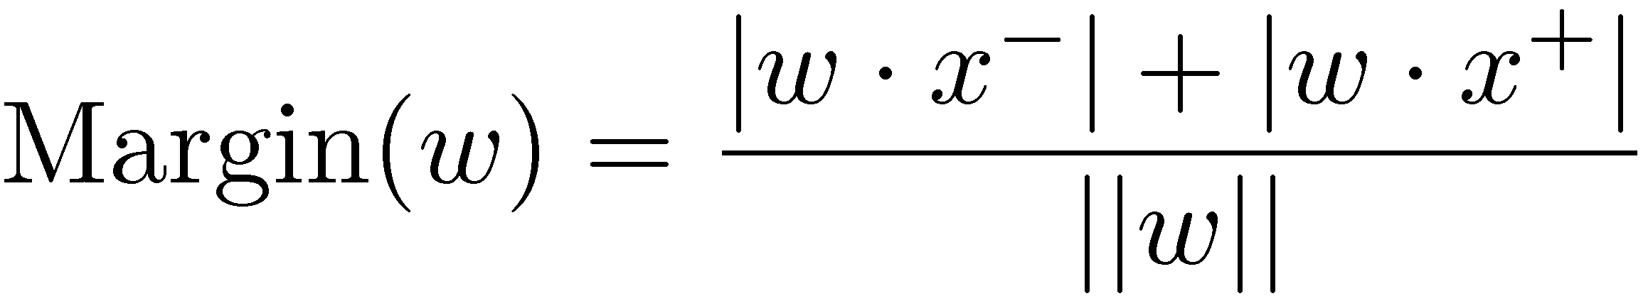
“Best” Hyperplane?
First, what is a hyperplane?
  A generalization of a line to higher dimensions
  Defined by a vector w
With SVMs, the best hyperplane is the one with the maximum margin
If x⁺ and x⁻ are the closest ‘+’ and ‘-’ inputs to the hyperplane, then the margin is:

Slide 4





Support Vector Machines
+
+
–
+
–
+
–
+
Margin
–
+
–
+
+
–
–
+
Hyperplane
–
–
–
+

Slide 5
Support Vector Machines
+
+
–
+
–
+
–
+
Margin
–
+
–
+
+
–
–
+
Hyperplane
–
–
–
+

Slide 6
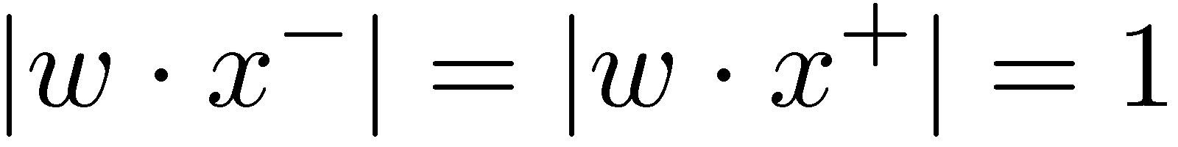
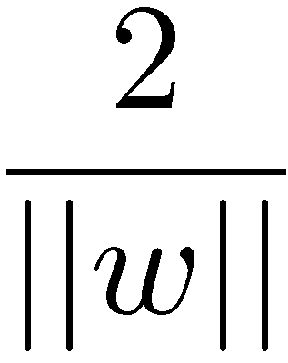
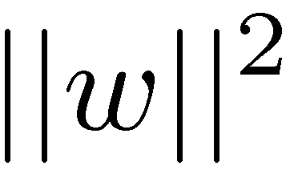
“Best” Hyperplane?
It is typically assumed that ,
which does not change the solution to the problem
Thus, to find the hyperplane with the largest margin, we must maximize .
This is equivalent to minimizing .

Slide 7
Separable vs. Non-Separable Data
+
+
–
–
+
+
–
+
+
–
+
–
+
–
+
–
–
–
+
+
+
–
+
–
+
–
–
+
–
+
–
–
+
+
+
+
–
–
–
–
Separable
Non-Separable

Slide 8
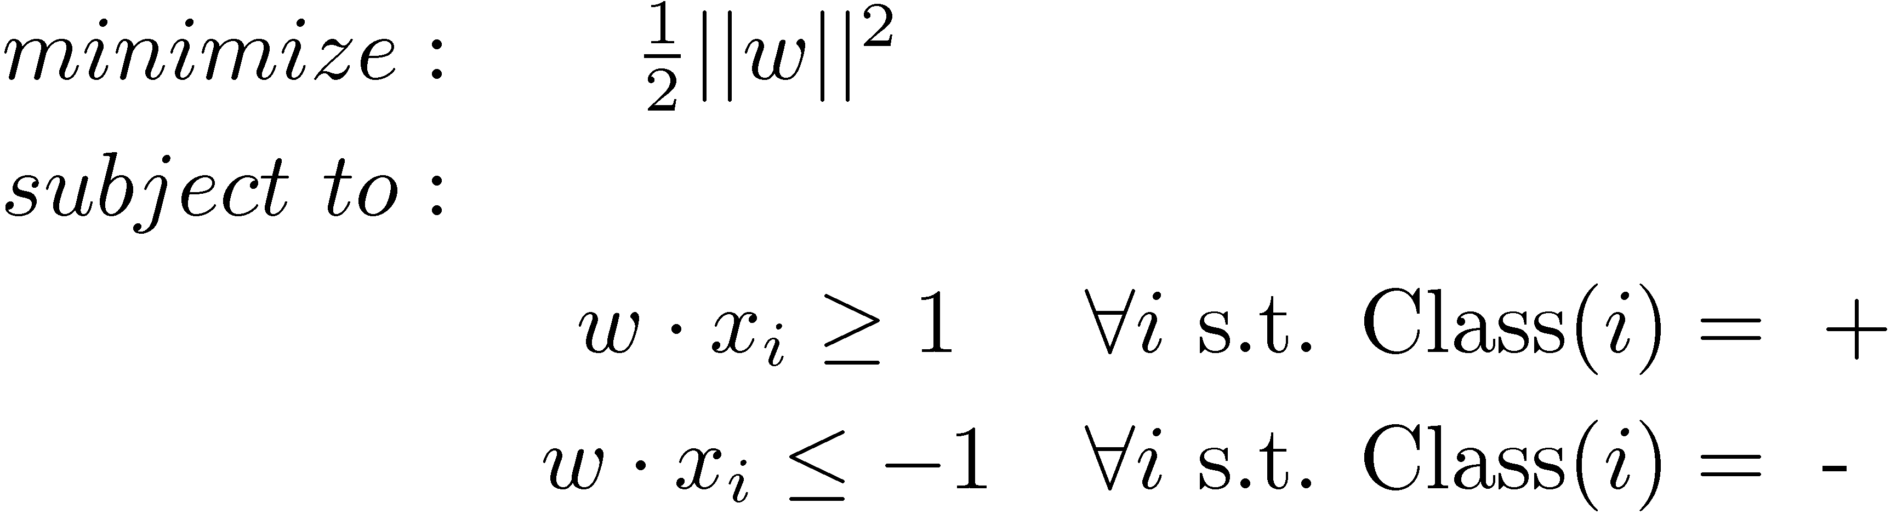
Linear Separable Case
In math:
In English:
  Find the largest margin hyperplane that separates the ‘+’s and ‘-’s

Slide 9
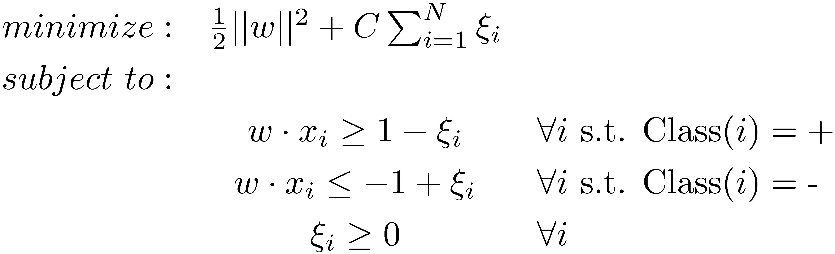
Linearly Non-Separable Case
In math:
In English:
  ξ_{i} denotes how misclassified instance i is
  Find a hyperplane that has a large margin and lowest misclassification cost

Slide 10
The Kernel Trick
Linearly non-separable data may become linearly separable if transformed, or mapped, to a higher dimension space
Computing vector math (i.e., dot products) in very high dimensional space is costly
The kernel trick allows very high dimensional dot products to be computed efficiently
Allows inputs to be implicitly mapped to high (possibly infinite) dimensional space with little computational overhead

Slide 11
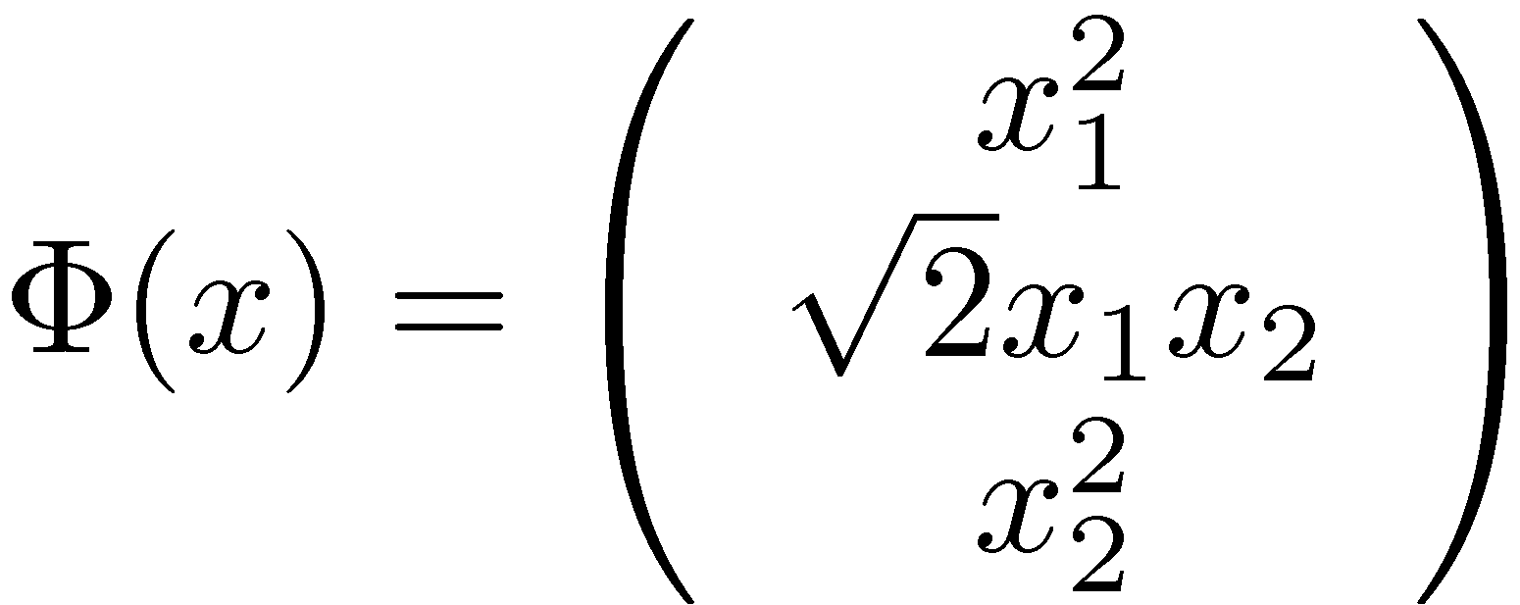
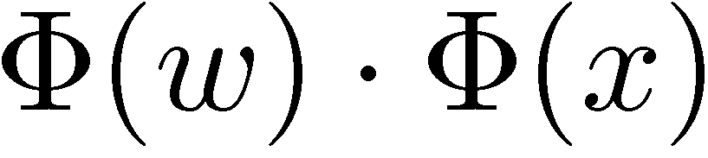
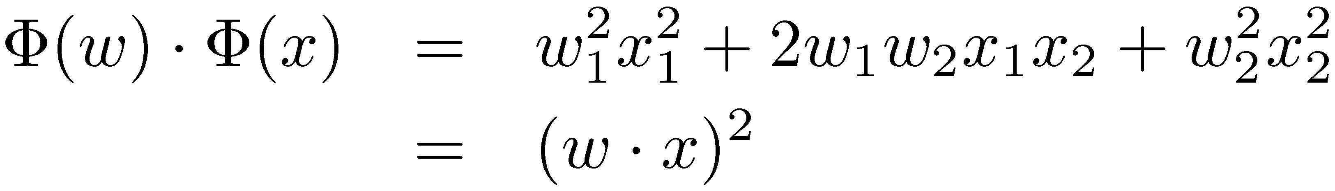
Kernel Trick Example
The following function maps 2-vectors to 3-vectors:
Standard way to compute is to map the inputs and compute the dot product in the higher dimensional space
However, the dot product can be done entirely in the original 2-dimensional space:

Slide 12
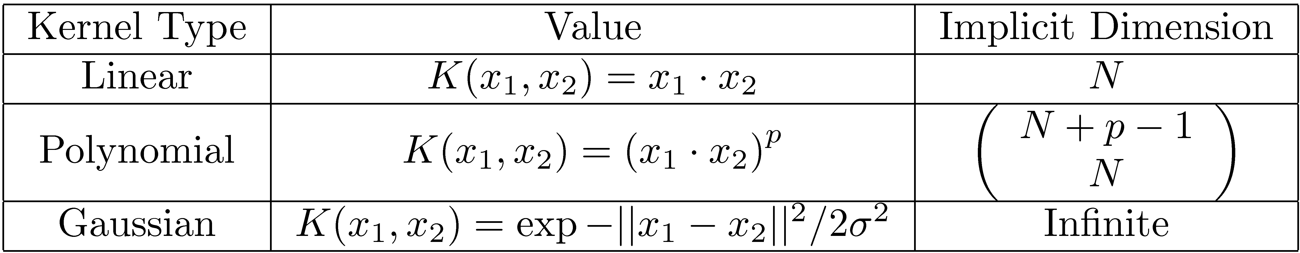
Common Kernels
The previous example is known as the polynomial kernel (with p = 2)
Most common kernels are linear, polynomial, and Gaussian
Each kernel performs a dot product in a higher implicit dimensional space

Slide 13
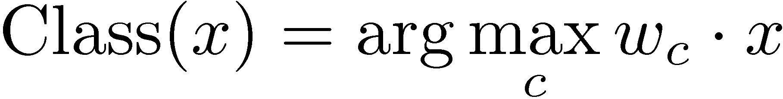
Non-Binary Classification with SVMs
One versus all
  Train “class c vs. not class c” SVM for every class
  If there are K classes, must train K classifiers
  Classify items according to:
One versus one
  Train a binary classifier for every pair of classes
  Must train K(K-1)/2 classifiers
  Computationally expensive for large values of K

Slide 14
SVM Tools
Solving SVM optimization problem is not straightforward
Many good software packages exist
  SVM-Light
  LIBSVM
  R library
  Matlab SVM Toolbox

Slide 15
Evaluating Classifiers
Common classification metrics
  Accuracy (precision at rank 1)
  Precision
  Recall
  F-measure
  ROC curve analysis
Differences from IR metrics
  “Relevant” replaced with “classified correctly”
  Microaveraging more commonly used

Slide 16
Classes of Classifiers
Types of classifiers
  Generative (Naïve-Bayes)
  Discriminative (SVMs)
  Non-parametric (nearest neighbor)
Types of learning
  Supervised (Naïve-Bayes, SVMs)
  Semi-supervised (Rocchio, relevance models)
  Unsupervised (clustering)

